Slide 1
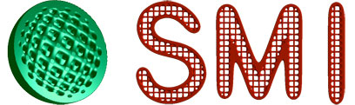
Point Cloud Normal Estimation via Low-Rank Subspace Clustering
Jie Zhang¹, Junjie Cao¹, Xiuping Liu¹, Jun Wang², Jian Liu¹, Xiquan Shi³
¹ CGGI Lab, Dalian University of Technology
² Nanjing University of Aeronautics and Astronautics
³ Delaware State University
Notes:
20 min talk (20 + 5 pages) + 5 min questions.
Thank you! We are going to discuss Point cloud normal estimation via Low-rank subspace clustering.
[It is a joint work by Jie Zhang, me, …]

Slide 2
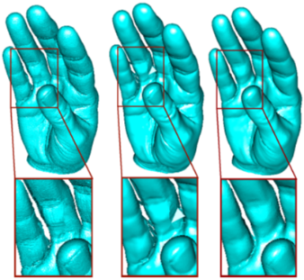
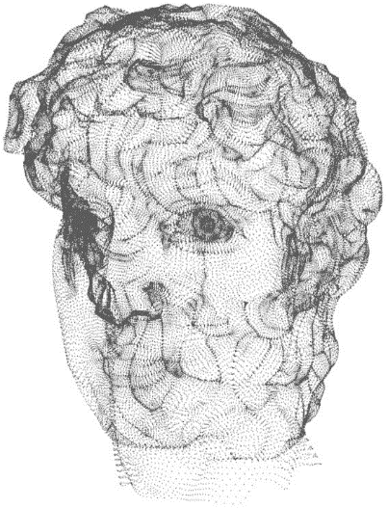
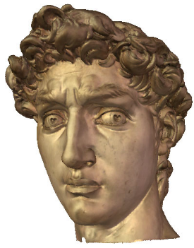
Why Normal Estimation is Important?
Contribute to
Point-based rendering
Primitive extraction
Feature preserving denosing
Surface reconstruction
…
NormFet+AMLS+Cocone [Dey et al.]
Cons [Huang et al.] +RBF
Notes:
Normal estimation is important to many applications.
[For example, Reconstruction methods without exploiting first order information prone to generate unfaithful results when the input point set contains some defects.
Recent methods produce impressive reconstruction, in the presence of additional normal information. ]
------------------ Comments ----------------------
Without normal: Tight cocone (Dey et al.), An integrating approach to meshing scattered point data
With normal: RBF(A multi-scale approach to 3d scattered data interpolation with compactly supported basis functions), Poisson surface reconstruction,
2

Slide 3
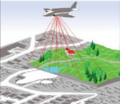
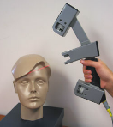
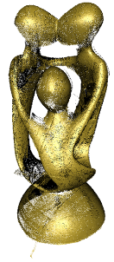
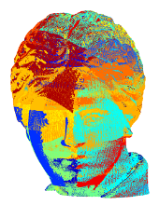
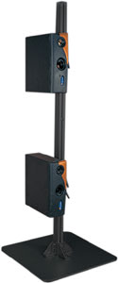

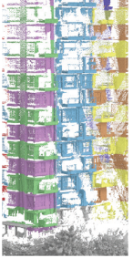
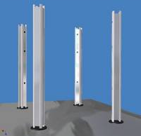
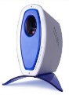
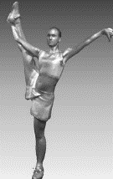
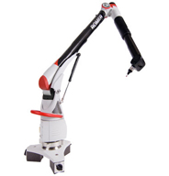

Scanning Devices & Raw Data
Notes:
Why do we estimate them, considering that some 3D scanners can offer such properties.
It is because that more low-cost general digitizing devices & computer vision algorithms do not provide such properties. So we have to estimate them.

Slide 4
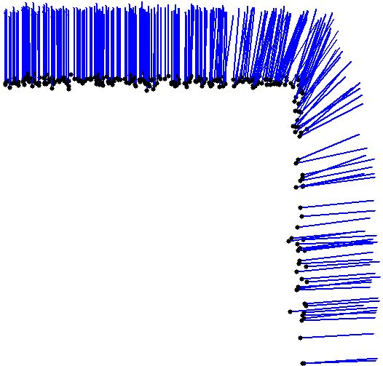

Challenge for normal estimation
Most often have sharp features
Non-uniform sampling
Notes:
The raw point data may contain noise, non-uniform sampling & sharp features Which bring challenges to robust normal estimation.

Slide 5
Outline
Related works
Our method
Basics of the method
Low-rank subspace clustering framework with prior knowledge (LRSCPK)
LRSCPK for normal estimation
Experiments
Notes:
In the following, I will present some related works, …,

Slide 6
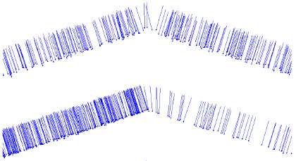
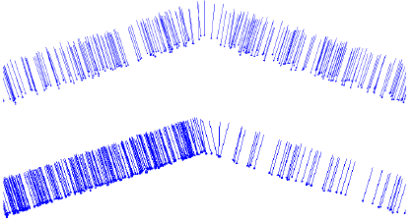
Related work
Delaunay/Voronoi Based Methods
Voronoi filtering [Amenta et al. 99]
Provable surface reconstruction from noisy [Dey et al. 06]
Voronoi-based variational reconstruction [Alliez et al. 07]
Normal mollification methods
- Bilateral filtering [Jones et al. 07]
- Half-uadraticre gularization [Calderon et al. 07]
- Robust local kernel regression [Oztireli et al. 09]
RANSAC-like method [Li et al. 10]
Regression Based Methods
-Principle component analysis (PCA) [Hoppe et al. 92.]
-Moving least squares (MLS) [Alexa et al. 01]
-Spheres [Guennbaud et al. 07]
-Adaptive neighborhood [Mitra et al. 03]
-Gaussian weights [Gross et al. 07]
-Robust moving least squares (RMLS) [Fleishman et al. 05]
-RANSAC-like method [Li et al. 10]
-Hough transform [Boulch et al. 12]
Hough transform [Boulch et al. 12]
Notes:
Many existing algorithms contribute to the problem, [and can be classified into regression based approach, normal mollification approaches, and Delaunay based methods.]
[Normal mollification methods depends on preliminary normal estimation.
Delaunay based methods failed to compute the normals near the sharp features accurately.
Regression-based methods tend to smooth sharp features when the whole neighborhoods are used to estimate normal.]
These two methods are the most recently proposed, focusing on estimating normals near sharp features. However, they may generated incorrect normals for the points extremely near the sharp features when the date contains noise or are non-uniformly distributed.
------------------ Comments ----------------------
HF introduces a uniform sampling strategy to overcome the influence of density variation. However, the computed normals are unreliable for the points near sharp features, as shown in Fig.1, especially when the dihedral angel is large.

Slide 7
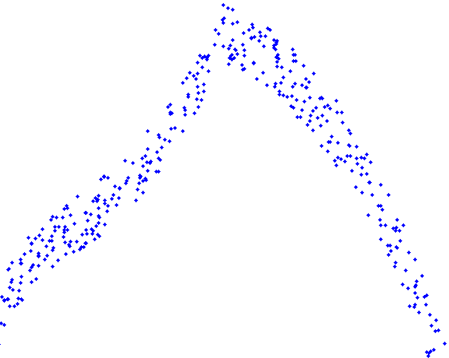
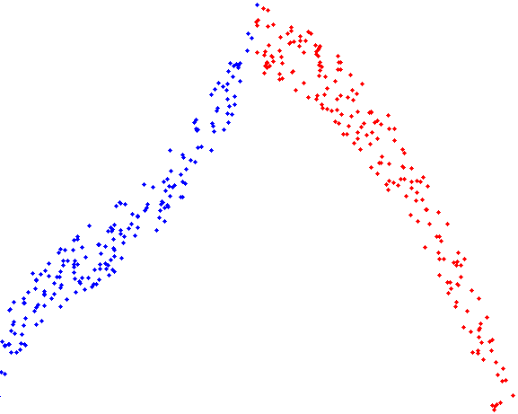
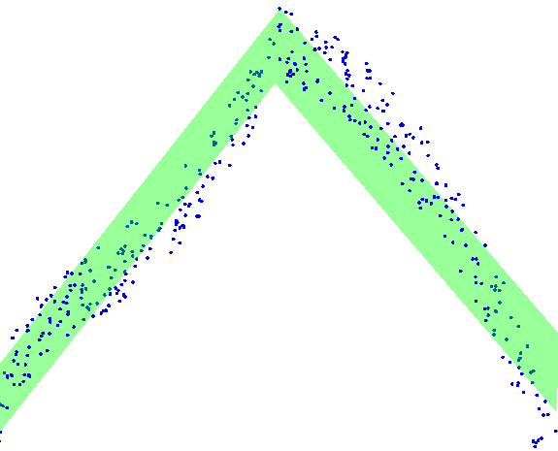
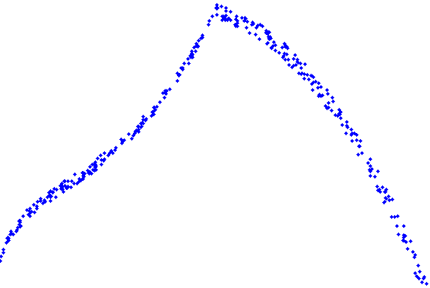
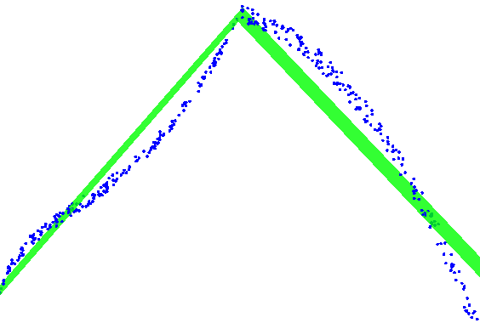
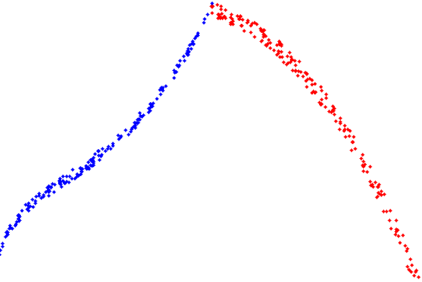
Basics of our method
Notes:
1.When the point is near sharp features, its neighborhood is anisotropic i.e. sampled from several piecewise surfaces.
2. These surfaces can be approximated by planes and each of them is a 2D subspace.
3. And we can identify these planes by our Low-rank subspace clustering framework with prior knowledge.
Even two points from different subspaces, are very close to the edges, they are distinguished faithfully.
Once a point’s neighborhood is segmented into different subspaces, it is easy to identify the most consistent one and compute accurate normal using it.
We have to note that the standard low rank representation model failed to do this.
--------

Slide 8
Contributions
A low-rank subspace clustering framework with prior knowledge (LRSCPK) is designed to avoid subspace independency assumption when applying LRR model.
LRSCPK is applied to segment isotropic sub-neighborhoods for point cloud data.
The estimated normals from identified consistent sub-neighborhood preserve sharp features better than existing methods
Notes:
Here are the contributions of our paper:
First, a low-rank subspace clustering …
Second, we demonstrate the utility of LRSCPK for segmenting isotropic …
Finally, the estimated normals …, even in the presence of noise and non-uniform samplings.
------------------ Comments ----------------------
The standard LRR model works under the assumption that the data are sampled from multiple independent subspaces.

Slide 9
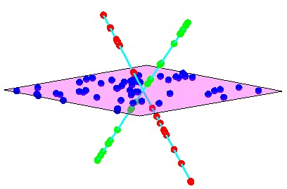
Subspace clustering
Algebraic algorithms
Iterative methods
Statistical methods
Spectral clustering-based methods
Robust Recover of Subspace
Structure by Low-Rank Representation
G. Liu, Z. Lin, and Y. Yu
2010 ICML
Sparse Subspace Clustering
Ehsan Elhamifar
2009 CVPR
Notes:
Before introducing our LRSCPK framework, I would like to introduce some related models in subspace clustering first.
A number of approaches have been proposed in the past two decades, [including algebraic methods, Iterative methods, statistical methods and spectral clustering-based methods.]
Inspired by the success of compressive sensing, recent advances in subspace segmentation make use of sparsity-based techniques which belong to spectral clustering-based methods.
The most distinguishing works are these two.

Slide 10
Representation based subspace clustering
Z is not unique!
X
- data set
- representation coefficient
=
X
Z
Use a function to choose a representation which can reflect the relation of
Affinity matrix
Notes:
Each data point, a column of X is expressed by a linear combination of other data, i.e. data set X can be linearly represented by themselves. each column of Z is its representation coefficients. For example, column i of Z is coefficients of data i.
However, the representational is not unique.
To generate a meaningful and unique Z, we need to minimize a proper function about Z.
For handling noise, the model is rewritten as this, i.e. X is not exactly represented by itself, the representation may take some errors E.
After getting Z, the affinity matrix S can be defined as … Then, Ncut method can be used to cluster the data set X.

Slide 11
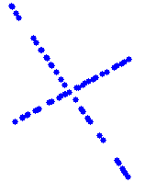
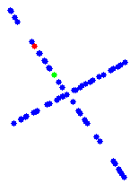
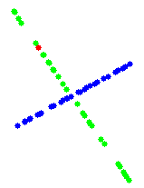
Sparse subspace clustering (SSC)
Low-rank representation (LRSC)
Notes:
The function f in Sparse subspace clustering is the l1 norm of Z and L21 norm of E. One more constraint diag(Z)=0 is added to avoid to select the identity matrix as the solution.
While as illustrated by the following example, using the generated Z, the red point may just represented by one point, such as the green one, since such Z will be more sparse than represent it with more points(, which leads to incorrect segmentation.)
To overcome this problem. Subspace clustering based on low-rank representation is introduced. It uses kernel norm of Z. Then the red point is presented by all the points within the same class, i.e. the representation is not sparse for points within the same class anymore. But the rank of Z is two, the lowest one satisfying this condition, it is a kind of sparse in 2D.
------------------ Comments ----------------------
2. As SSC finds the sparsest representation of each data vector individually, there is therefore no global constraint on its solution.
3. LRSC aims to take the correlation structure of data into account, it finds a low rank representation instead of a sparse representation.
====================================================================================================================
LRSC’与SSC的异同说明：
SSC
优点：
1、It has been shown that when the subspaces are independent , the solution to SSC is block diagonal。
2、Ehsan Elhamifar show that under certain conditions relating the principal angles between the subspaces and the distribution of the data points across all the subspaces, the sparse coefficients Is also block diagonal.
（Ehsan Elhamifar Ren´e Vidal，Clustering disjoint subspaces via sparse representation ，ICASSP， 2010 1926-1929 ）
缺点：
3. But this solution does not guarantee to obtain a correct segmentation, since it may be ”too sparse”, which divides the within-cluster data into different groups.（Nasihatkon gives failure examples in dimensions higher than three.<B. Nasihatkon, R. Hartley, Graph connectivity in sparse subspace clustering, in: CVPR, 2011, pp. 2137–2144.>）
对这一点的解释
If there is a group of data points among which the pairwise correlations are very high, then sparse
representation tends to select only one, at random. Thus, SSC is not able to capture
the correlation structure of data from the same subspace.
换一种说法：
（As SR finds the sparsest representation of each data vector individually, there is therefore no global constraint on its solution.）
4. The sparsity also brings about the loss in the locality of the features to be encoded. Similar features may be encoded as totally different sparse codes. Thus, these
codebooks result in the instability of the sparse coding. Such instability may harm the robustness of the sparse coding based computer vision applications.
LRSC:
优点：
5. LRSC aims to take the correlation structure of data into account, it finds a low rank
representation instead of a sparse representation.
6. It can be shown that when the subspaces are independent, the solution to problem LRSC is
unique and block diagonal.
7. Given a set of data samples approximately drawn from a union of multiple
subspaces, LRSC can segment the samples into their respective
subspaces and correct the possible noise as well. (Robust).
缺点：
8. When the subspaces are not independent, this method may fail.

Slide 12
Not suitable for normal estimation
Limitation
When the subspaces are not independent, this method may fail.
Input
Segmentation results of LRR
Notes:
However, When the subspaces are not independent, LRSC may fail.
The top row is input & the bottom row is output of three tests.
In the 1st column, the two subspace is independent, i.e. the sum of their dimension is less than or equal the dimension of their union. In this example, they are both two.
In the 2nd column, the sum is 4 and the dimension of their union is 2, i.e. the 4 subspaces are dependent, so the LRSC failed. The 3th column is an other failure case.

Slide 13

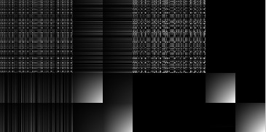
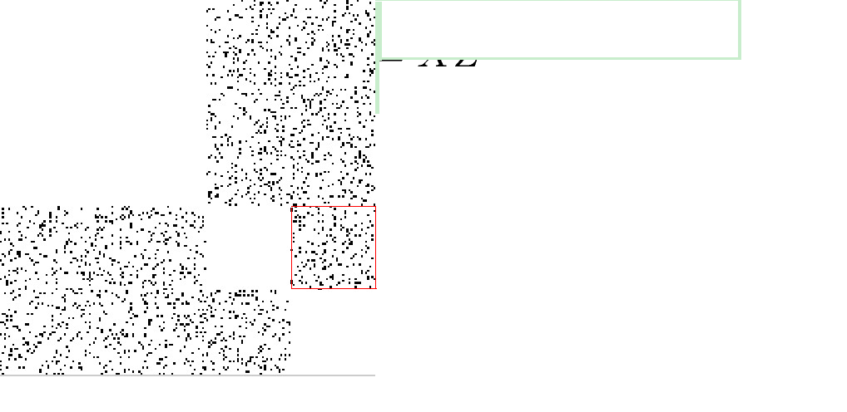
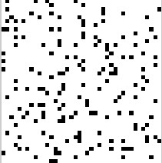
Improvement
prior knowledge
an affinity matrix which is dense within same class and sparse between different classes is preferred!
Notes:
We design a new low-rank subspace clustering framework with prior knowledge (LRSCPK), for more general subspace clustering. P_omega is a selection operator, it select some elements from Z. if Omega(I,j) equals to 1, Z(I,j) is selected.
The reason why LRSC failed to segment this data is it generates a Z like this, [a point is represented by both points within the same class and points within different class. i.e. the representation between different class is too dense. ]
Actually, an affinity matrix which is dense within same class and sparse between different classes is preferred!
Like this. Which leads to correct segmentation.
If we know which pair of points belong to different subspaces, we can set constraints for them. Note that only part of such info is enough, even these info contain noise.
These black points mean that we know these elements corresponding to points from different subspaces, part of all such info, & we select them from Z & wish them approximate 0.
These black points means the prior knowledge. With them a better representation Z & affinity matrix S can be generated.

Slide 14
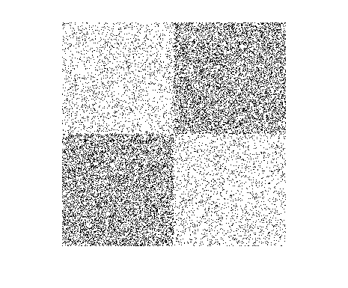
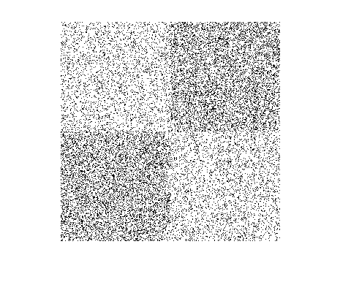
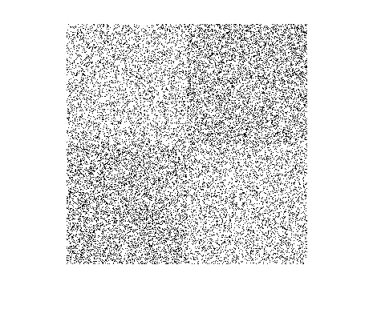
(a)
(b)
(c)
(d)
(a) The result of LRR (11% clustering error). From (b) to (d) are the results of
LRSCPK with 40% prior knowledge which are corrupted by 20%, 30% and 40% errors, respectively. The clustering error is 0, 0 and 1%.
Notes:
A toy example is provided to verify the effectiveness and robustness of LRSCPK.
As illustrated by (a), (b) and (c), LRSC fails to segment two dependent subspaces, while LRSCPK generates faithful segmentation using partial prior knowledge even with considerable levels of errors.
These black points means that we know the corresponding points I and j are belong to the same or different planes, and 20%, 30% & 40% of them are intentionally set wrong, i.e. they should be 0 we use 1 or they should be 1 we use 0.
----------------------------
Moreover, when the prior knowledge is seriously corrupted by errors, LRSCPK still provides a more qualified segmentation than LRSC, as shown in (d).

Slide 15
Outline
Related works
Our method
Basics of the method
Low-rank subspace clustering framework with prior knowledge (LRSCPK)
LRSCPK for normal estimation
Experiments
Notes:
In the following, I will show you how to use this framework to estimate normals, especially how to estimate the prior knowledge.

Slide 16
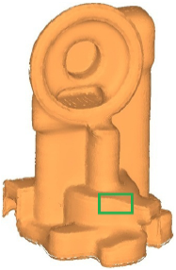
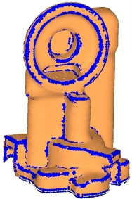
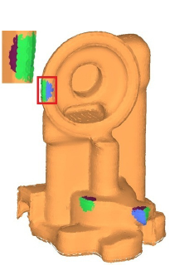
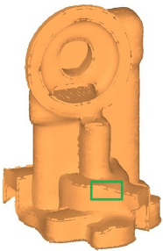
Overview of our algorithm
Input: a noisy point cloud
Candidate feature points selection
Subneighborhood segmentation
- Using LRSCPK to construct affinity matrix
- Using the affinity matrix to get the
segmentation results
Normal estimation
Notes:
With a noisy point cloud as input, candidate feature points, these blue points, are estimated first;
Then LRSCPK is applied to segment the neighborhoods of any candidate feature point into potential sub-neighborhoods;
At last, a consistent sub-neighborhood is identified and utilized to conduct normal estimation.

Slide 17
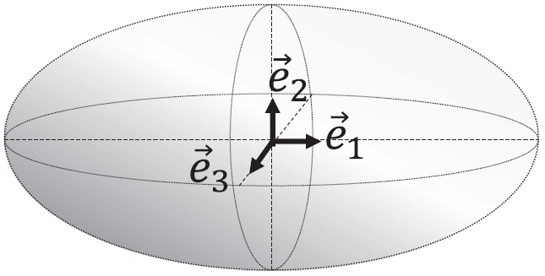
Candidate feature points selection
For each point define covariance matrix
2. Use weight measures the confidence of belonging to a feature.
3. If is larger than a given threshold then is regarded as a candidate feature point.
Notes:
Many methods can be applied here to select candidate feature points.
We use the most common one: covariance analysis of the neighborhood of a point.
The weight $wi$ is computed as …
$wi$ measures the confidence of $pi$ belonging to an edge or corner.
Usually, larger wi means that pi is more likely a feature point.
If $wi$ is larger than a given threshold wt then $pi$ is regarded as a candidate feature point.
We choose the $wt$ after the first peak of the l1-smoothed distribution of $wi$ where a gentle decrease occurs.
The red points in the figure are candidate feature points for this model.

Slide 18

Subneighborhood segmentation
Using LRSCPK to construct affinity matrix
How to construct the priori knowledge?
Use the low quality normal to compute a distance matrix.
Construct a guiding matrix based on this distance matrix.
Refine
Notes:
For each candidate feature point, we apply LRSCPK to construct an affinity matrix.
The question is how to construct the priori knowledge, i.e. \omega?
First, A distance matrix is computed using the raw normals by PCA.
Then a guiding matrix is constructed based on the distance matrix and refined later.

Slide 19
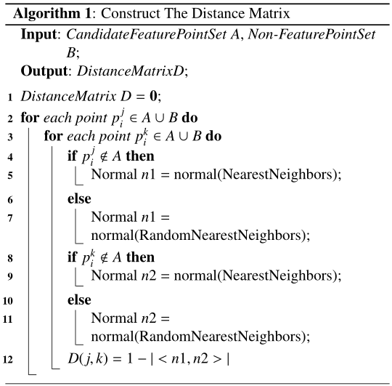
Construct a distance matrix D of raw normals
D(j,k) = 1- |<n_{j,}n_{k}>|
The point is away from sharp features.
Normal estimated by PCA is enough.
The point is adjacent to sharp features.
PCA on randamly selected neighbors.
Notes:
Denote the distance matrix as D.
D( j,k ) is the distance of raw normals of point j and k.
two points with similar normals have a small distance. It can be seen as the probability of points j and k belonging to different planes.

Slide 20
Construct the guiding matrix
Refine the guiding matrix
If only one of point j or k is around sharp features
If both of them are near sharp features
( j, k) = 1, if D( j, k) >
( j, k) = 0, otherwise.
Notes:
Then we set ( j, k) = 1 if D( j, k) is large, i.e. they belong to different subspace, and & ( j, k) = 0 otherwise.
Actually when point j or k is near sharp features, the normal estimated [using some random points from a point’s K-nearest neighbors] is not reliable.
Therefore the reliability of the probabilities D( j, k) is lower. So we lower the probability according to whether point j or k is near sharp features or both of them are near sharp features.

Slide 21
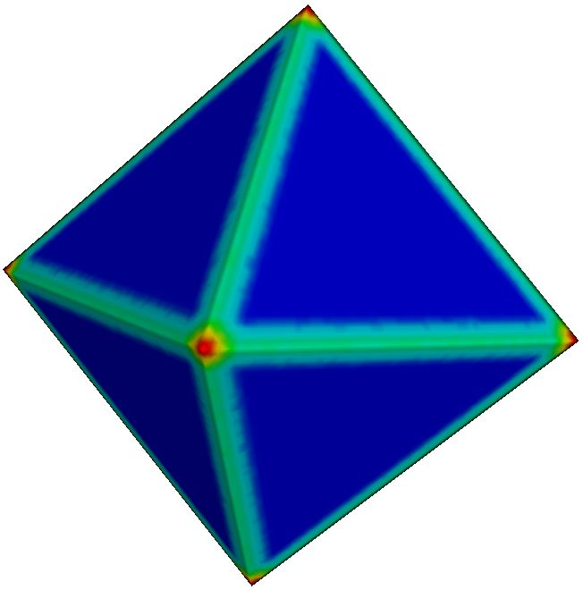
Refine the guiding matrix
Sequence of computing
The points around sharp features usually have a higher weight than the point far away from sharp features.
The point with a large weight usually corresponding to a complex construct.
Notes:
We may further improve the guiding matrix by considering the sequence of computing it.
Do you still remember the weight used to select candidate feature points? The point far away from sharp features usually has lower weight & has simpler structure, which means it is easier & more credible to cluster its neighborhood.
Hence, we cluster the neighborhood of the point away from sharp features first, then the point near sharp feature. We save the numbers of a pair of points i and j belonging to the same sub-neighborhood, i.e. subspace, and the number of them belonging to different subspaces.
These info are used to refine the guiding matrix of points with higher weights, which are computed the points with lower weights.

Slide 22
Refine the guiding matrix
Sequence of computing the guiding matrix
the number of point j and k in the same subspace
the number of point j and k in the different subspaces
When the
When the
Notes:
R & N are the numbers we saved.
We use these two formulas to refine the guiding matrix further.
If j & k has far more chances to within the same subspace, we lower the possibility of they belong to different subspaces, and vice versa.

Slide 23
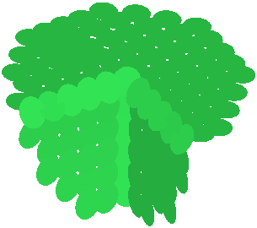
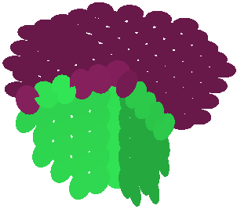
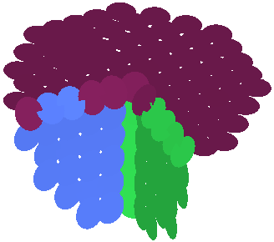
Subneighborhood segmentation
NCut
clustering result
How to choose the number of smooth region
The choice of . The red dashed line represent where the threshold is selected
Notes:
With the guiding matrix, our framework - LRSCPK generates the affinity matrix S, and Ncut is used to cluster a point’s neighborhood.
We segment the neighbors into two classes first.
If any one of them is not a subspace, it is segmented into two classes further.
The iterative progress is terminated until each class is a subspace.
Determining whether or not a class is a subspace is performed by fitting a plane to the class and measuring the average residual. (If the average residual is smaller than a threshold , the class is determined as a subspace.)
The threshold for the average residual is computed adaptively.
[We compute normalized average residual histograms of candidate feature points and non-candidate points respectively and set f as the x coordinate of the point where the two histograms cross.]

Slide 24
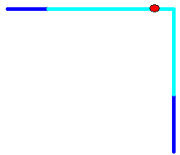
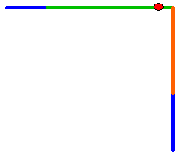
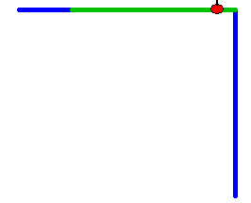
Normal estimation
Given a point and its neighbourhood.
The result of segmentation.
Choose a neighbourhood and estimate the normal.
Notes:
1. Given a point and its neighbourhood.
2. We segment the neighborhood into several subneighborhoods.
3. Then an accurate normal can be easily estimated using the isotropic subneighborhood.

Slide 25
Outline
Related works
Our method
Basics of the method
Low-rank subspace clustering framework with prior knowledge (LRSCPK)
LRSCPK for normal estimation
Experiments
Notes:
Now, I will show you some experiments

Slide 26
Sharp features with shallow angles
Octahedron model with 50% noise
results rendered using surfels
visualization of bad points
top view of the generated normals
PCA
[Hoppe et al. 92]
RNE
[Li et al. 10]
HF
[Boulch et al. 12]
OUR
Notes:
Here, we compare the normal estimation results of the Octahedron model. It contains sharp features generated by two intersection planes with shallow angles.
From left to right are the estimated normals by PCA, RNE, HF and our method.
From the top to the bottom visualize the results in different ways. they are surfel representation, visualization of bad points, and top view of the generated normals.
(Normals estimated by PCA are overly smoothed near sharp features.
Those of HF are also a bit smooth, since normals produced by triples sampled from different sides are likely to vote for the same bin when the angle is shallow.)
Bad points: are points whose estimated normals deviate from the reference normals greater than 10 degrees.
The number of bad points is smaller than other methods.
The bottom row shows clearly that our algorithm preserves sharp features better.

Slide 27
Neighborhood with multiple features
Fandisk model with 50% noise
results rendering using surfels
visualization of bad points
top view of the generated normals
PCA
RNE
HF
OUR
Notes:
These are results of the Fandisk model.
The neighborhood of a point may contain multiple edges. The complex neighborhood structure brings challenges to the existing methods.
Other methods generate more bad points around the narrow-band regions. Our method utilizing the neighborhood’s structure information does not have this flaw.
Again, the top view of the generated normals shows that our method preserves shape features.

Slide 28
The bad point distributions
Octahedron model
Fandisk model
These points could have two directions.
Notes:
These are bad points distributions of PCA, RNE, HF and our method for the Octahedron and Fandisk models.
We notice that the number of bad points from our method are much less than other methods in all normal deviation regions from 10 to 90 degree nearly.
For the Fandisk model, PCA obtains the smallest number of bad points with normal deviation between 80 to 90 degrees among all compared methods. It is because that the normals near sharp features by PCA are excessively smoothed and the largest deviations are almost 40 to 60 degrees.
The higher deviation between the 80 to 90 degrees from RNE, HF and our method is mainly because that heavy noise makes the intersection of two planes becoming a ribbon, not a line, where the points are supposed to have two directions there, & one of them may deviate from the input normals about 90 degrees.

Slide 29
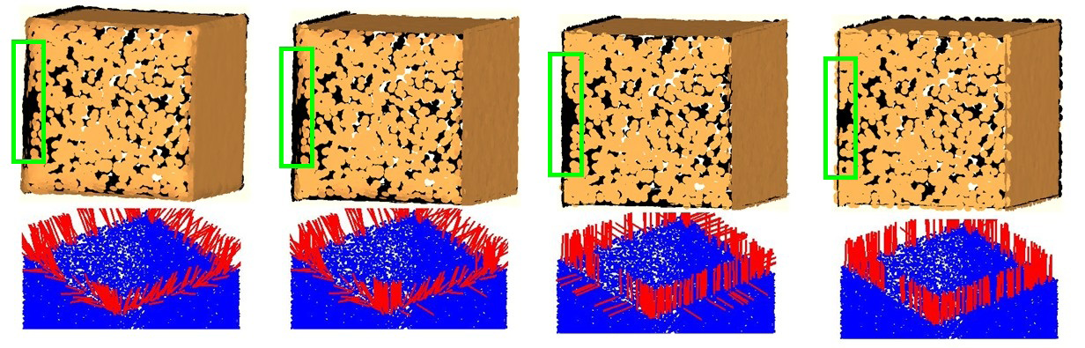
Variational density near sharp features.
Cube model with 50% noise
Density:1
Density: 5
Density:10
PCA
RNE
HF
OUR
The bottom row contains the top view of computed normals of the front face of the Cube model.
Notes:
This figure shows the normals estimated on a Cube sampled with face-specific variations of density.
PCA and RNE are severely affected by the non-uniform sampling.
Since HF has designed a sampling strategy to deal with density variation, it performs better than the two. However, there are still some errors near sharp features.
Our method can effectively overcome the sampling anisotropy around sharp features

Slide 30
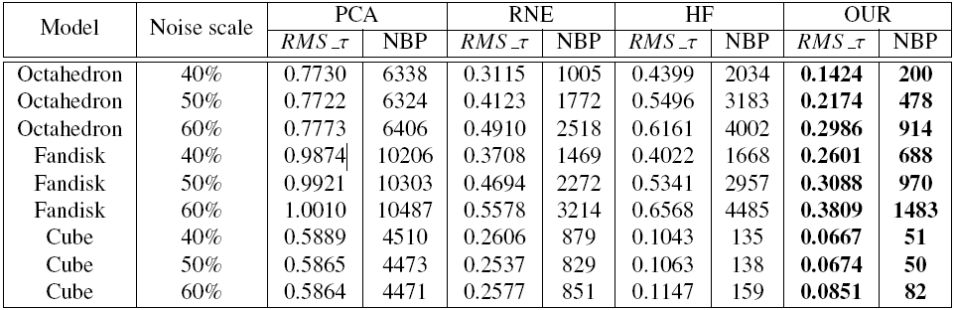
Root Mean Square measure with threshold
Notes:
To evaluate our method more precisely, models with different noise scales are computed.
RMS and the number of bad points (NBP) are presented.
2. The statistics illustrate that our method achieves the lowest RMS and NBP. i.e. More accurate normals are estimated under different noise scales by our method.

Slide 31
Notes:
We also apply our method to some real scanned point clouds in which the typical imperfections, such as noise, outliers and non-uniform distribution are ubiquitous.
our algorithm recovers edges faithfully.

Slide 32
Notes:
1. The Taichi model has complex structures in the marked region. Our algorithm preserves the sharp feature well even in such complicated case.
2. The Genus2 model contains close-by surface sheets in the marked regions. The normal estimation approaches based on distance, such as PCA and its variants, tend to be affected greatly, while our structure based method not.

Slide 33
Notes:
1. Tiny structures challenge normal estimation. The Shutter contains many such tiny structures. When some of them are sampled adequately as the marked region, faithful normals are estimated by our method and the tiny structures can be visualized clearer.

Slide 34
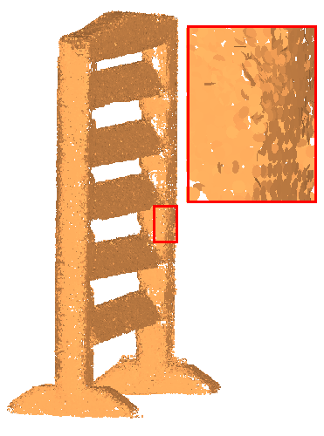
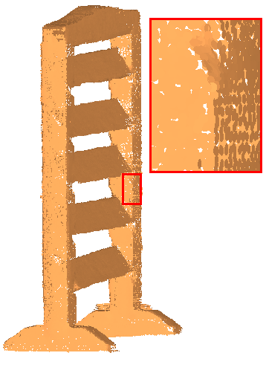

RNE
HF
OUR

Slide 35
Outline
Related works
Our method
Basics of the method
Low-rank subspace clustering framework with prior knowledge (LRSCPK)
LRSCPK for normal estimation
Experiments
Other application (Sharp feature detection)
Notes:
In the following, I will present some related works, …,

Slide 36




Sharp feature detection
Non-feature point!
Feature point!
Notes:
We further demonstrate the effectiveness of our neighborhood segmentation algorithm on sharp feature detection, which is a fundamental problem in geometry analysis.
The sharp features are usually detected as the intersection of multiple piecewise smooth surfaces.
For each candidate feature point i, we segment its neighborhood into some subneighborhoods and fit a plane for each.
If there is more than one planes which include $pi$ , we consider $i$ as a feature point.

Slide 37


Noise-free models
Noise models
10% noise
20% noise
Notes:
There are sharp feature detection results of three different models.
For these noise-free models, our method achieves almost perfect detection results.
In order to demonstrate the robustness of our method, the results of Fandisk models with 10% and 20% Gaussian noise (perturbed by centered Gaussian noise with the standard deviation of 10% and 20% average distance between points) are shown.
Our method is able to detect the sharp features in different noise scales. Moreover, the weak features are recovered.

Slide 38
Park et al. 12
10% noise
20% noise
Our method
10% noise
20% noise
Notes:
Here are the comparison between the recent method by Park et al and ours.
Their method fails to restore weak features perfectly and some weak feature points at the top of the model are missing.
While our method is capable of recovering more weak feature points to a large extent.

Slide 39
Conclusion
We provide a new low-rank subspace clustering framework with prior
knowledge.
We use LRSCPK to segment and identify consistent subneighborhood.
The estimated normals preserve sharp features even in the presence
of noise and anisotropic samplings.
Limitation
Our method requires a substantial amount of computation time to solve
a optimization problem at each candidate feature point.

Slide 40
Acknowledgements
Anonymous Reviewers
Bao Li and Alexandre Boulch for providing the code for comparison
Andrei Sharf and Hui Huang for some models used
NSFC (No. U0935004 & No. 61173102, 61173103, 91230103)
Research Funds for the Central Universities (No. DUT13JS04)
Notes:
At end, we’ll thank anonymous reviewers for their useful comments; authors of some related papers for code and models in experiments; and the organizations listed for their generous support.
40

Slide 41
The End!
Thanks

